Slide 1
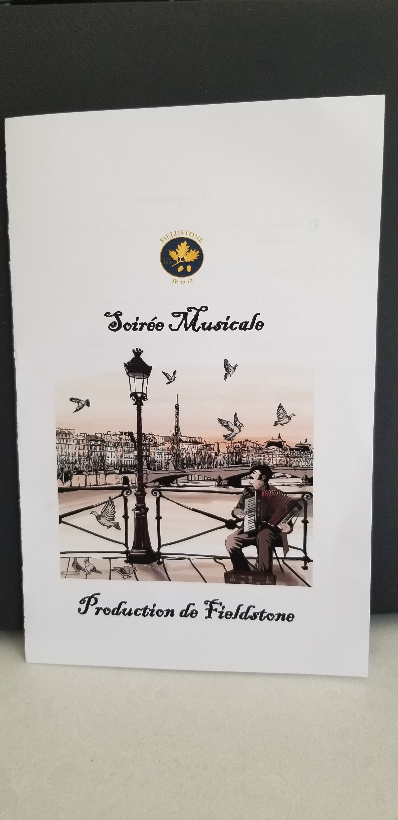
31 mai 2024

Slide 2
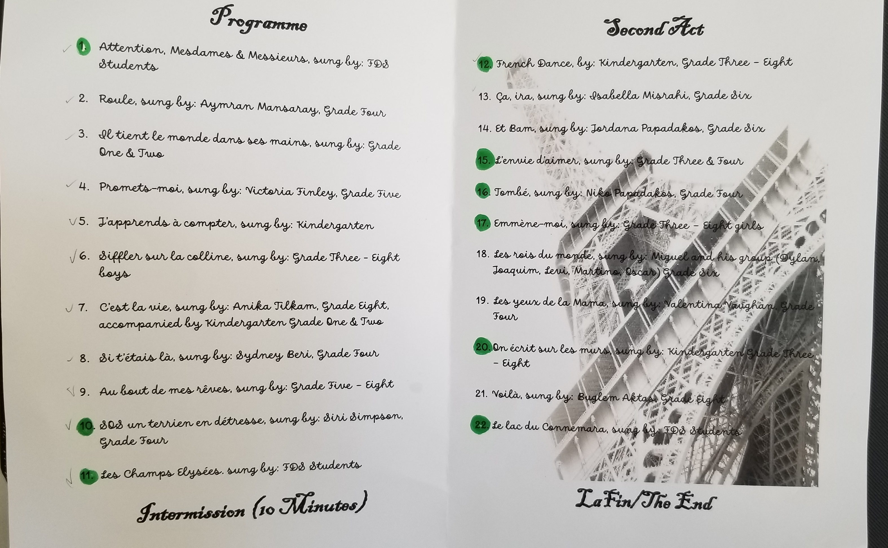

Slide 3
Opening

Slide 4
1. Attention, Mesdames & Messieurs sung by FDS Students

Slide 5
2. Roule, sung by Aymran Mansaray, Grade Four

Slide 6
3. Il tient le monde dans ses mains, sung by Grade One & Two

Slide 7
4. Promets-mois, sung by Victoria Finley, Grade Five

Slide 8
5. J’apprends à compter, sung by Kindergarten

Slide 9
6. Siffler sur la colline, sung by Grade Three – Eight boys

Slide 10
7. C’est la vie, sung by Anika Tilkam, Grade Eight, accompanied by Kindergarten Grade One & Two

Slide 11
8. Si t’etais là, sung by Sydney Beri, Grade Four

Slide 12
9. Au bout de mes rêves, sung by Grade Five - Eight

Slide 13
10. SOS un terrien en détresse, sung by Siri Simpson Grade Four

Slide 14
11. Les Champs Elysées, sung by FDS Students

Slide 15
12. French Dance, by Kindergarten, Grade Three - Eight

Slide 16
13. Ça ira, sung by Isabelle Misrahi, Grade Six

Slide 17
14. Et Bam, sung by Jordana Papadakos, Grade Six

Slide 18
15. L’envie d’aimer, sung by Grade Three & Four

Slide 19
16. Tombé, sung by Niko Papadakos, Grade Four

Slide 20
17. Emmène-moi, sung by Grade Three – Eight girls

Slide 21
18. Les rois du monde, sung by Miguel and his group

Slide 22
19. Les yeux de la Mama, sung by Valentina Vaughan, Grade Four

Slide 23
20. On écrit sur les murs, sung by Kindergarten, Grade Three - Eight

Slide 24
21. Voilà, sung by Buglem Aktas, Grade Eight

Slide 25
22. Le lac du Connemara, sung by FDS Students

Slide 26
La Fin

