Slide 2
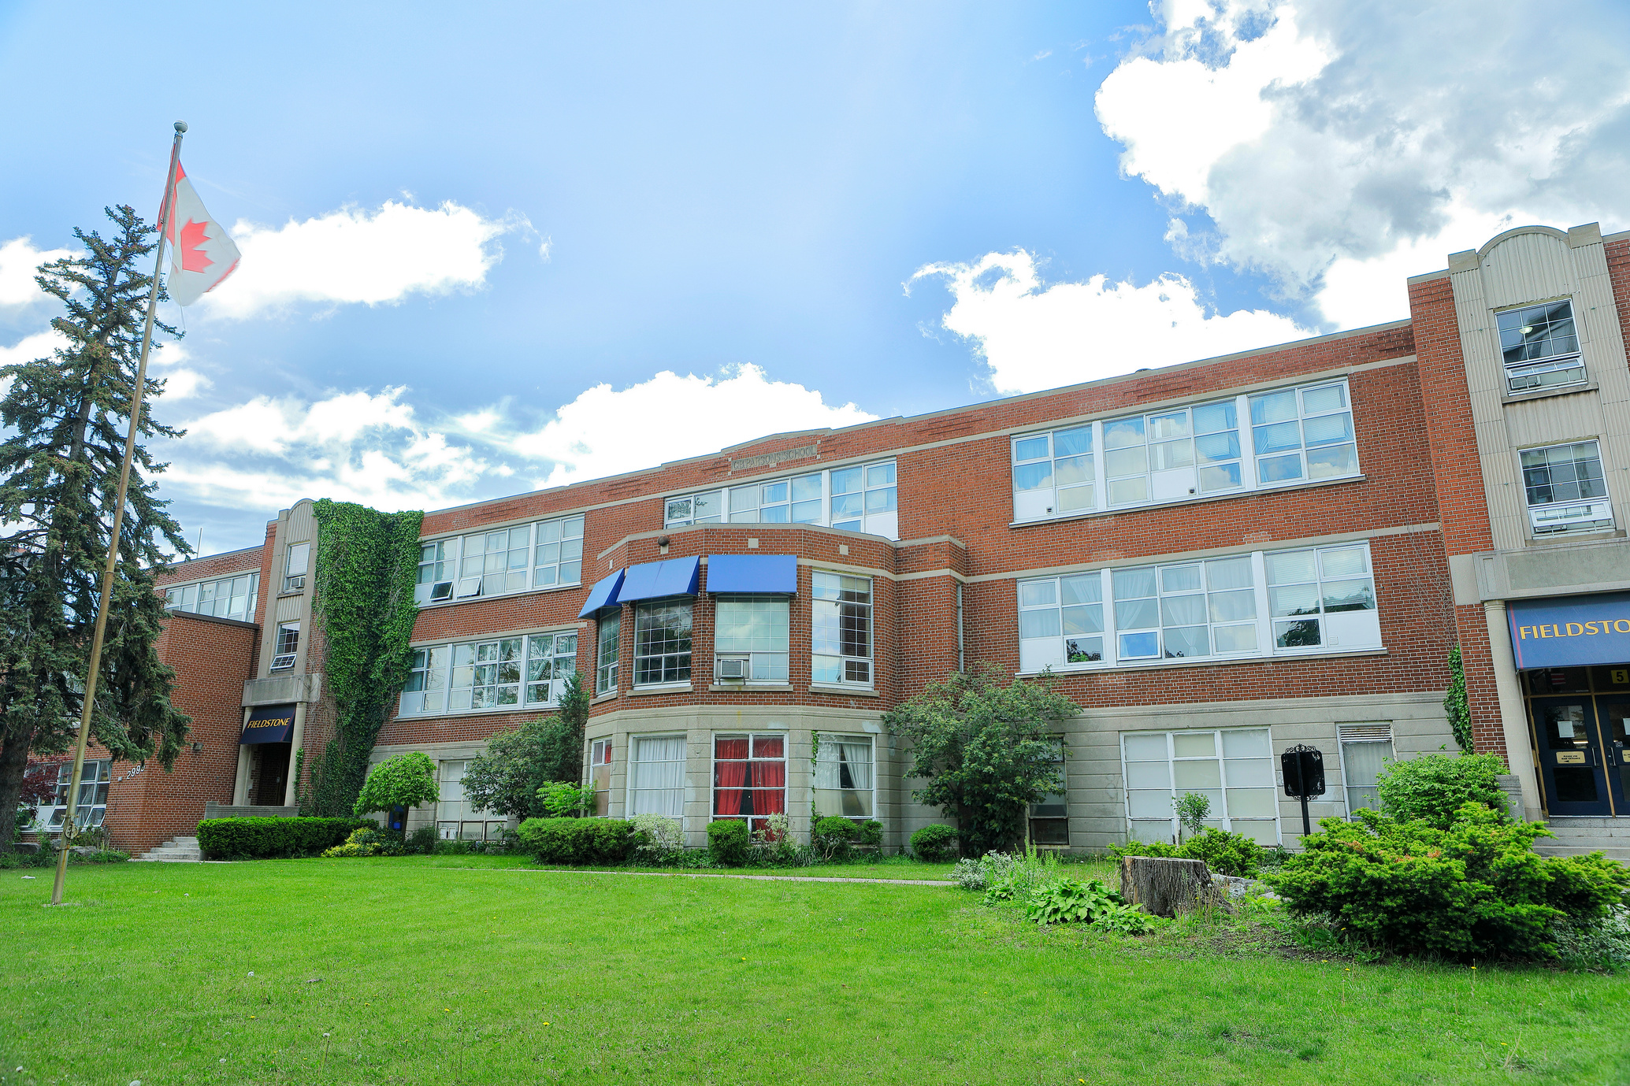
Fieldstone School
School Overview
Location: Toronto, Ontario, Canada
Established: 1997
Founded with the vision of holding students to higher expectations than other schools
Rooted in 'Global Knowledge' based on E.D. Hirsch’s Core Knowledge, adapted with Canadian content and French
2009: Adopted Cambridge International curriculum (Grades 6–12)
2015: Extended the Cambridge curriculum to Kindergarten–Grade 12
2024: Cambridge Showcase School for the August 2024 to July 2027 cohort
Emphasizes academic excellence within a caring and supportive environment

Slide 3
This is to confirm that
Fieldstone King's College School
is an authorized Showcase School
for Cambridge International Education
August 2024 – July 2027
Mark Cavone
Regional Director, North America, International Education Cambridge University Press & Assessment

Slide 4
Fieldstone School
Why Choose Fieldstone?
The first school in Canada to offer a dual Cambridge-Ontario curriculum
Selected as a Cambridge Showcase School for the August 2024 - July 2027 cohort
All students starting in Grade One learn how to play the violin, viola, or cello
All students in JK to Grade Twelve learn a Shakespeare Play
6.4-acre campus with outdoor field, gym, cafeteria, stage, art studio, music studio
University pathways counselling and one-on-one support
Teacher-led tutorials
Essay and interview prep for students applying to the U.K. and U.S. post-secondary institutions
Student leadership opportunities throughout the school year
One of the top 25 private schools in the Greater Toronto Area

Slide 5
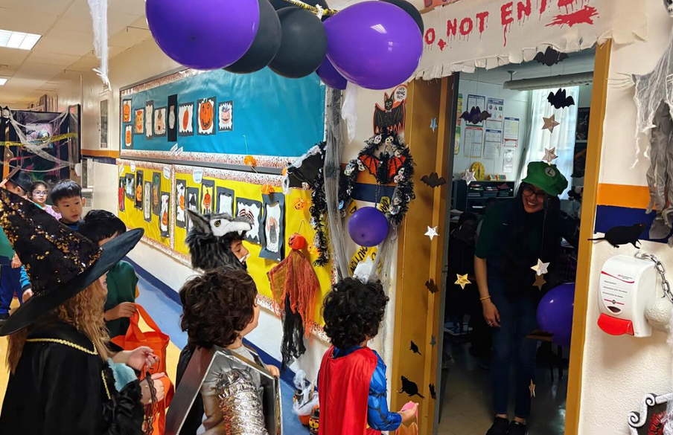
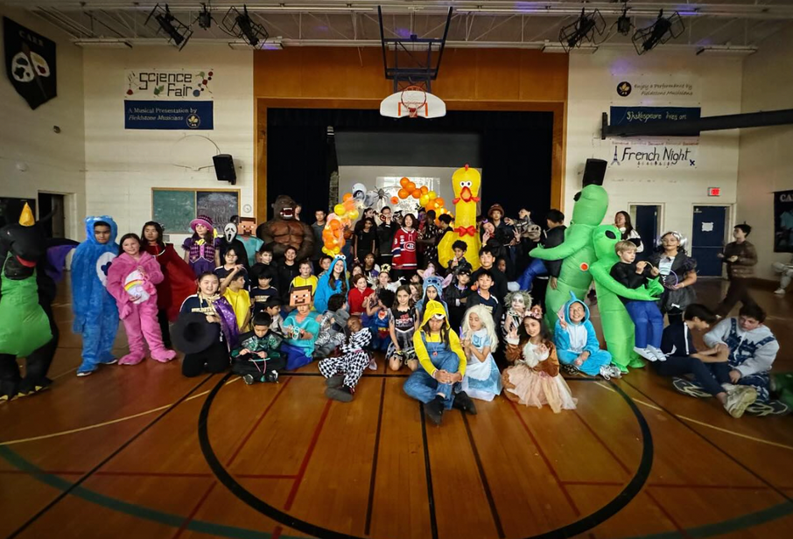
Fieldstone School
Student Life
Halloween (October 2024)

Slide 6
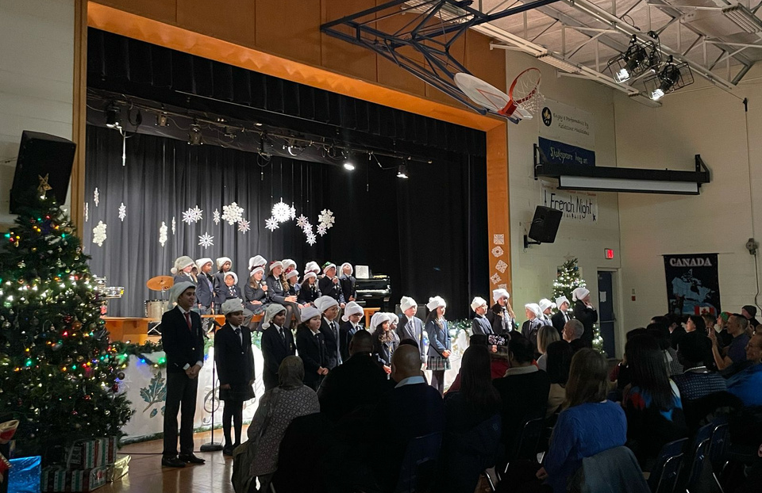
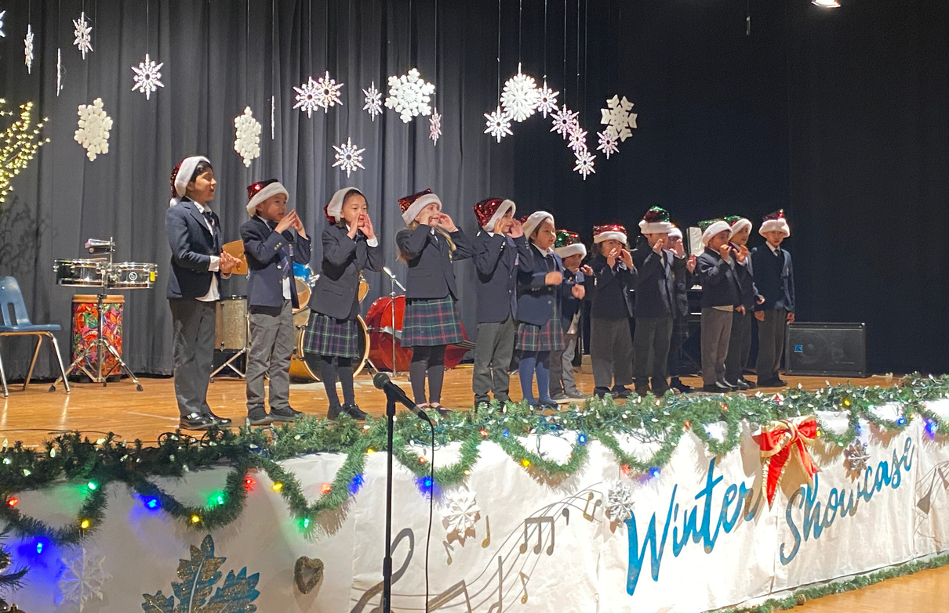
Fieldstone School
Student Life
Winter Showcase (December 2024)

Slide 7
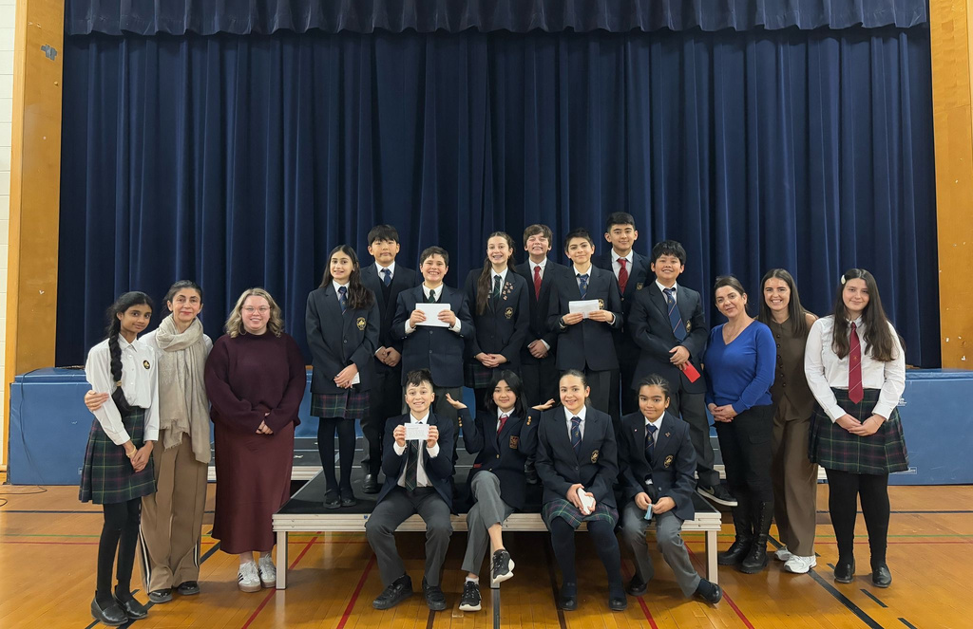
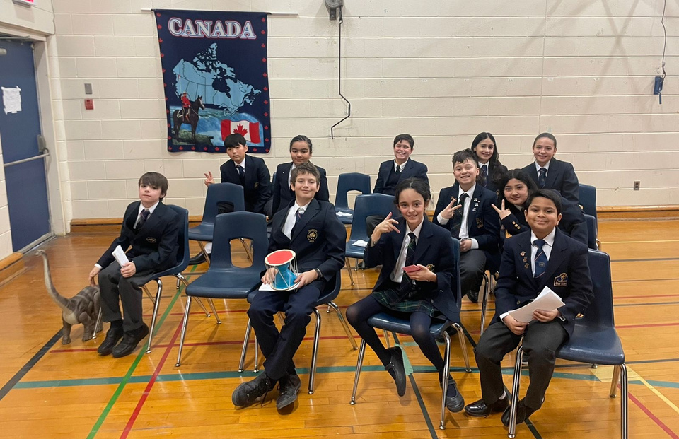
Fieldstone School
Student Life
Public Speaking (February 2025)

Slide 8
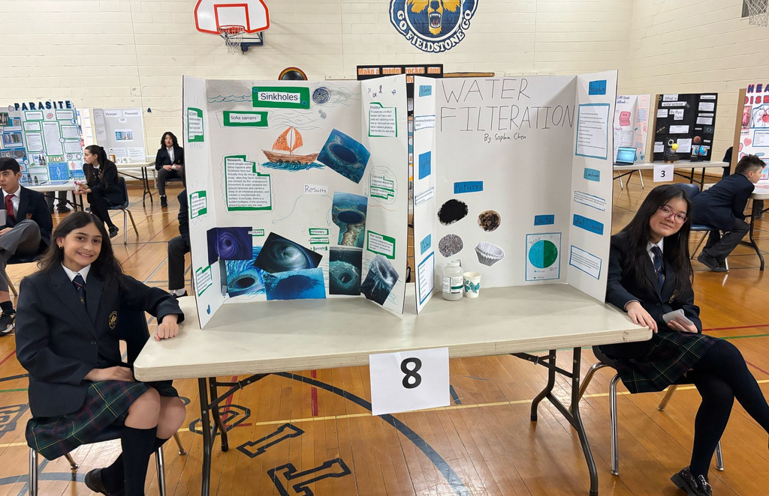
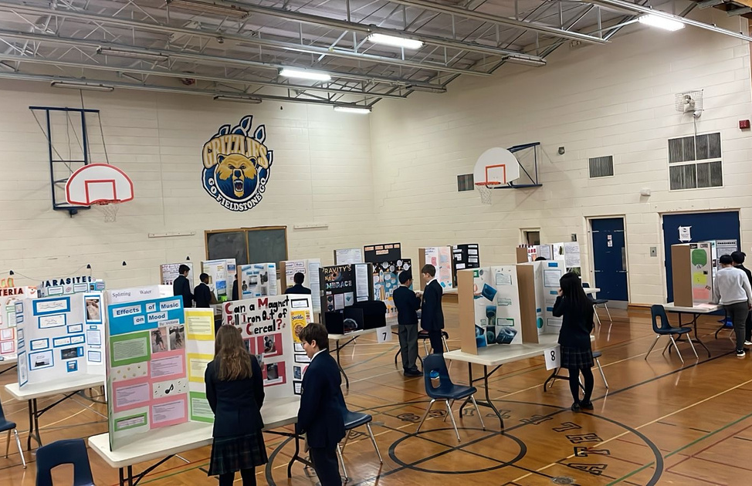
Fieldstone School
Student Life
Science Fair (February 2025)

Slide 9
Fieldstone School
Student Life
Cultural Showcase (March 2025)

Slide 10
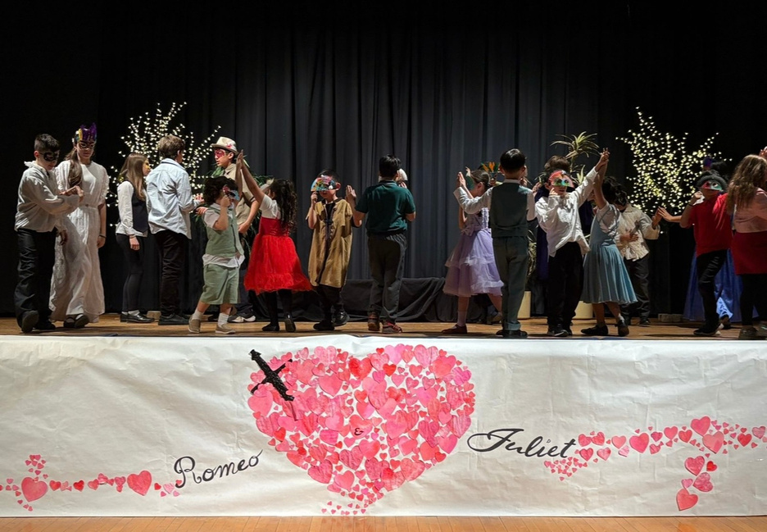
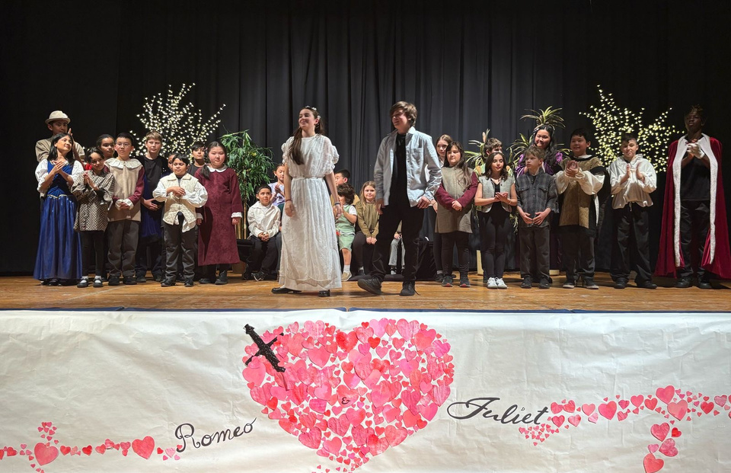
Fieldstone School
Student Life
Shakespeare - Romeo and Juliet (April 2025)

Slide 11
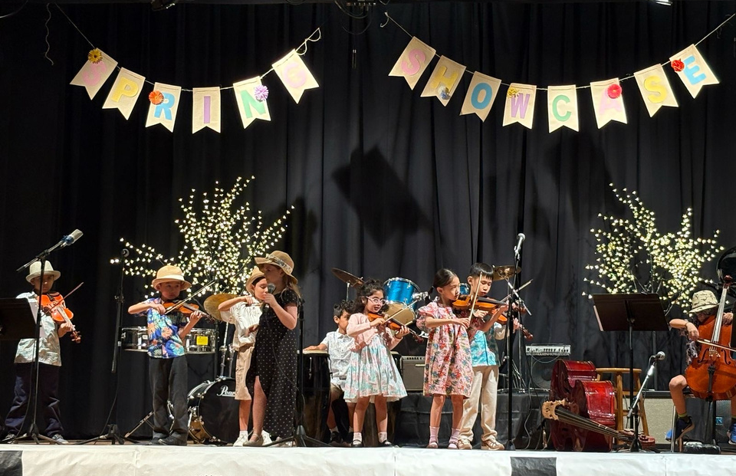
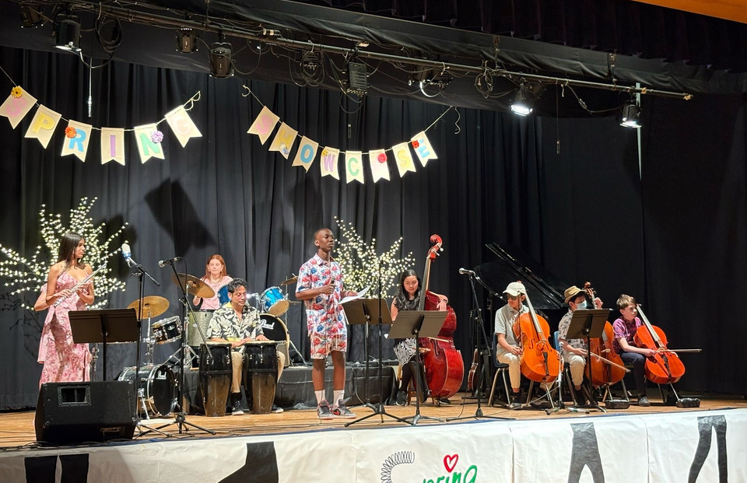
Fieldstone School
Student Life
Spring Showcase (April 2025)

Slide 12
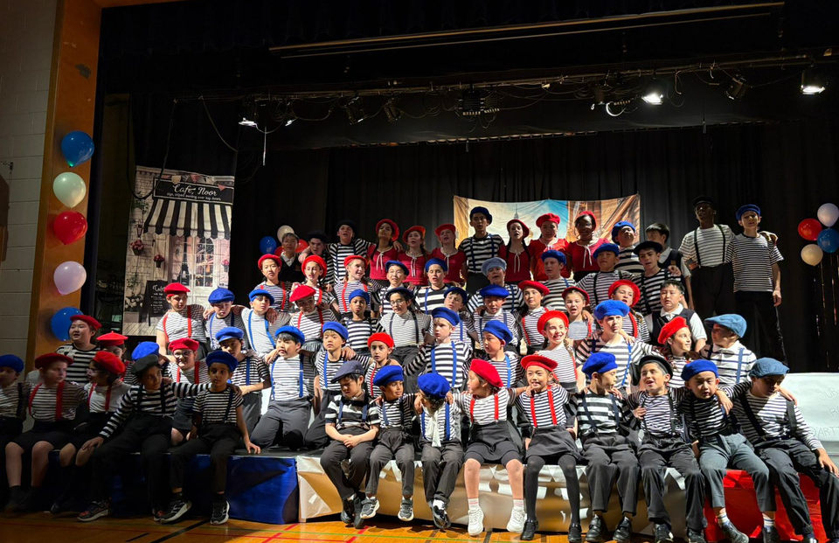
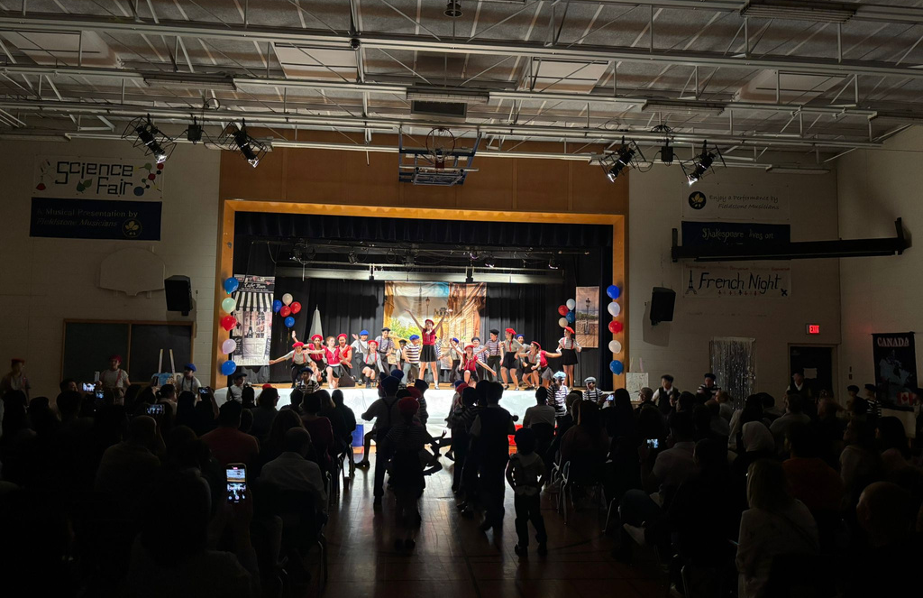
Fieldstone School
Student Life
French Night (May 2025)

Slide 13
Fieldstone School
Clubs
Field Trips & Events
Art Club
Book Club
Chess Club
Choir Club
Coding Club
Cyber Kids
Debate Club
Drama Club
French Club
Math Club
Sports Club
Yearbook Club
Yoga Club
*Clubs vary each year to reflect student interests
Astronomy in Action
Canada’s Wonderland
Downey's Farm
Halloween Dance Party
Legoland
Moving Zoo
Ripley's Aquarium
Scientists in School
Ski Trip
The Distillery Historic District

Slide 14
Fieldstone School
Notable Achievements of 2024–2025
A. Finley (Grade 3) – 2nd Place, Royal Canadian Legion Public Speaking Contest 2025
J. Papadakos (Grade 7) – 2nd Place, Royal Canadian Legion Public Speaking Contest 2025
M. Trinh (Grade 7) – 3rd Place, Royal Canadian Legion Public Speaking Contest 2025
S. Chen (Grade 6) – Debut Performance, Royal Conservatory of Music
M. Wantuch (Grade 7) – Silver Medal, Toronto Science Fair
V. Kaloty (Grade 5), T. Rodrigues (Grade 6), S. Chen (Grade 6) – Finalists, Unexpected Voices Competition 2025

Slide 15
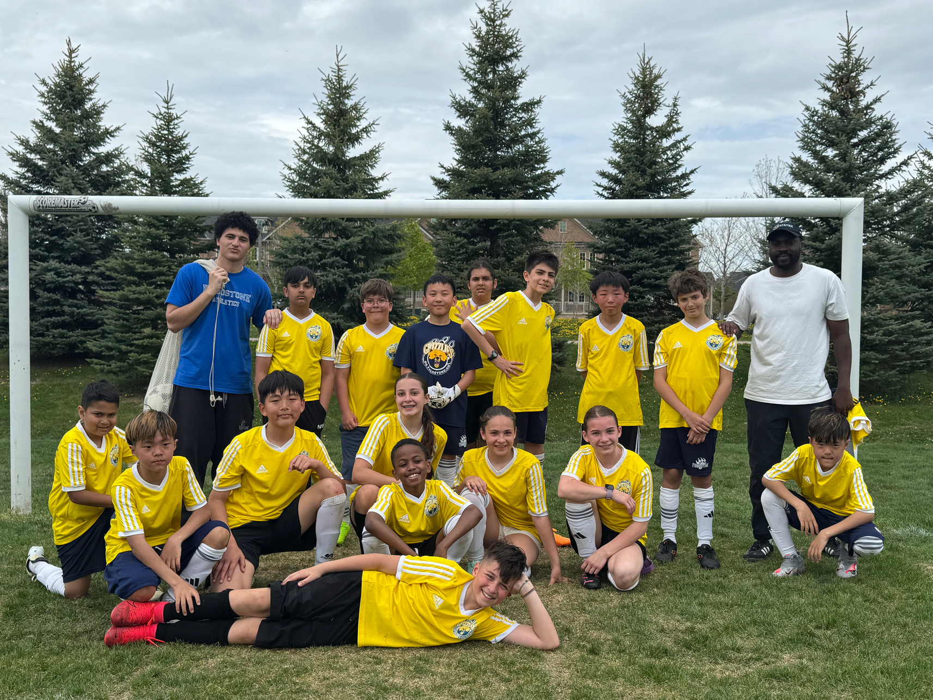
Fieldstone School
Athletics & Tournaments
Proud member of the SSAF (Small Schools Athletic Federation)
Students participate in a variety of sports, including Volleyball, Badminton, Track & Field, Bowling, Soccer, and more

Slide 16
Fieldstone School
University Destinations (2003 - 2025)
Our graduates have been accepted to top universities across Canada, including but not limited to:
University of Toronto
University of British Columbia (UBC)
University of Waterloo
McGill University
Queen’s University
Rutgers Business School
McMaster University
University of Ottawa
Western University
University of King's College
Dalhousie University
Simon Fraser University
York University
OCAD University
Carleton University
Toronto Metropolitan University

Slide 17
Fieldstone School
University Destinations (2003 - 2025)
Our graduates have been accepted to top universities across the world, including but not limited to:
Harvard University
Johns Hopkins University
Dartmouth College
New York University (NYU)
Parsons School of Design
University College London (UCL)
King’s College London
University of the Arts London
University of Southampton
University of St Andrews
University of Hong Kong
The Paris Institute of Political Studies (Sciences Po)
Keio University
Sophia University
Yonsei University
Ewha Womans University

Slide 18
Fieldstone School
Admissions
Rolling admissions – applications accepted year-round
Main intake periods
September 2025
January 2026

Slide 19
AT FIELDSTONE, WE SEE NOT THE CHILD WE MEET
BUT RATHER WHO THAT CHILD WILL BECOME

